Slide 1
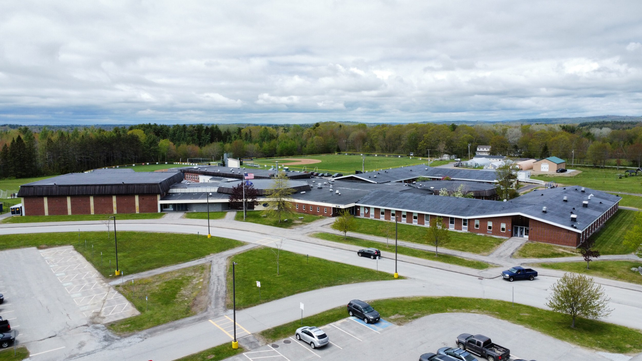



Medomak Valley High School
Performance Contract – Facility Enhancements
February 5, 2026

Slide 2
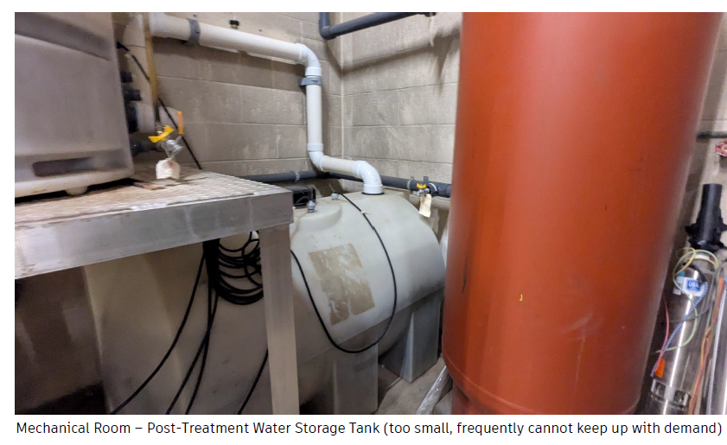
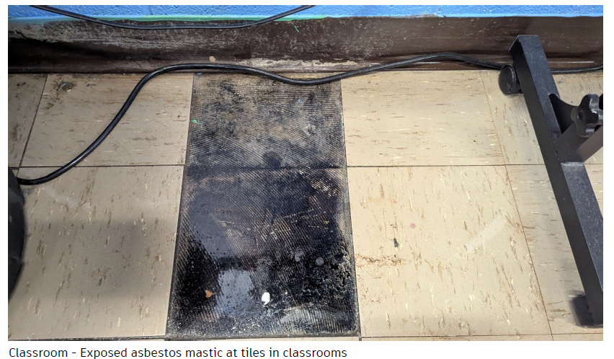
Maine School Revolving Renovation Fund Awards
MVHS Asbestos Abatement-$1,469,458
MVHS Water Quantity Improvements- $493,574 (second highest rated application)
Union Ventilation- $2,000,000
Total Awarded to RSU40: $3,963,032

Slide 3
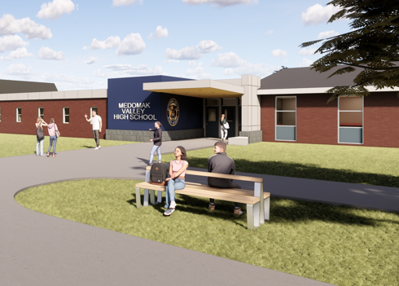
Summary of Project Scope
Bathroom Renovations
Locker Room Renovations
Security Vestibule
Ducted ERV system for Ventilation and Removal of Unit ventilators
Building Sprinkler System
Science lab Upgrades
Asbestos Abatement
Ceiling tile replacements
Building Controls Upgrades
Administrative and Special Education reconfiguration for space optimization
Art Area Reconfiguration

Slide 4
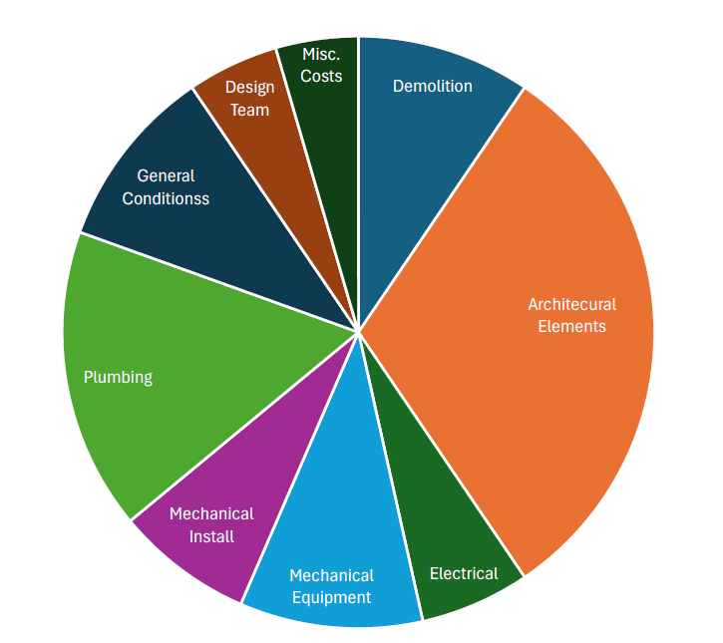

RSU 40 High School Improvement Project Scope Breakdown
Framing and Interior Finishes

Slide 5
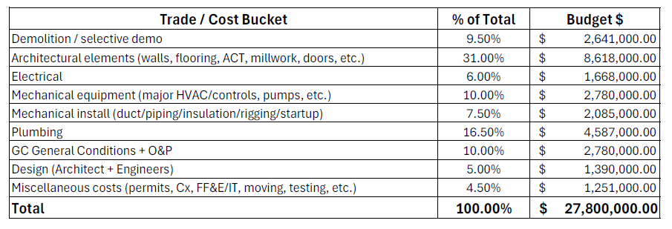
RSU 40 High School Improvement Project Scope Breakdown

Slide 6
HS Project Total Option: $24,911,164
Overall project will be broken down into a multi phased project approach starting with SRRF funded projects and the HS work continuing through 2028
-$1,200,000- Lighter Renovation of Locker Room and underground plumbing
-$65,000- LVT instead of MCT Flooring
-$1,123,836- Apply Asbestos abatement Revolving renovation fund and Water Quantity SRRF Funds
-$500,000- Remove Library HVAC
Potential Bond Vote Total: $24,911,164

