Slide 1
RSU 40
EEI Project Updates

Slide 2
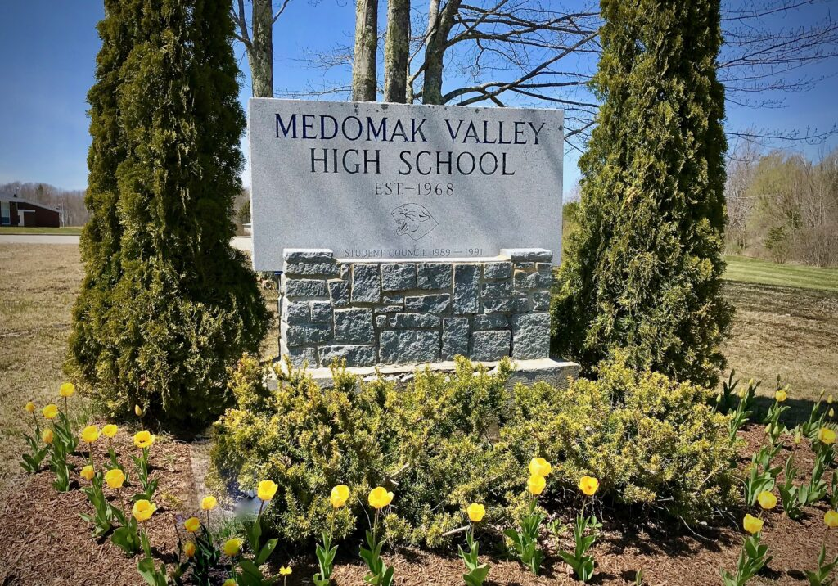
Overview
Ph. 3 Project Development
Maine State Revolving Renovation Funds
High School Improvement Performance Contract

Slide 3

Ph. 3 Project Developmentt
Project | School
Septic System Replacement | MVHS
Oil Fired Boiler Replacement with LP Condensing and Mechanical Room Improvements | MVHS
High School Ventilation | MVHS
Replace Water Treatment System Window Replacement throughout Union | MVHS Union
Replacement of Ventilation System on basement level | Union
Upgrade valves and Controls | Miller
Controls Upgrade (removal of penuematics) | Union
Exterior Lighting– Summer 2025 | Miller, Prescott and Warren
Noise Issue with Ventilation Unit (Insulation)- Spring/Summer 2025 | Prescott
Replacement of Boiler Room | Prescott
Condensing Boiler Propane Conversion | Friendship
Electric Hot water Heater | Friendship
Boiler Room Upgrade and Propane Conversion | Warren
Friendship Controls Upgrade | Friendship
Ventilation Unit Replacements (end of life) | Miller
Replacement of Inoperable Gym Ventilation Unit | Friendship
Add Basement Ventilation | Friendship
2025 Project
2025 Spring Projects
Remaining to be evaluated for ph. 3
Revolving Renovation Fund Applications
HS Water Storage Issues
HS ADA Application
HS Asbestos Abatement
Union Basement Ventilation
Friendship Gym Ventilation Replacement

Slide 4
Project Planning Timeline
Winter/Spring 2026
*Results of SRRF Funds
*Finalize Scope for HS Project
*Ph. 3 Project Development
Spring of 2026
*HS Performance Contract begins to be introduced to the communities through Town Halls and Educational forums.
Summer of 2026
HS Biomass Project Construction completes
*Ph. 3 begins construction
*HS project begins finalization of planning post June Vote
2026-2028
*HS Project finalizes development and is phased into construction over 2 summers

Slide 5
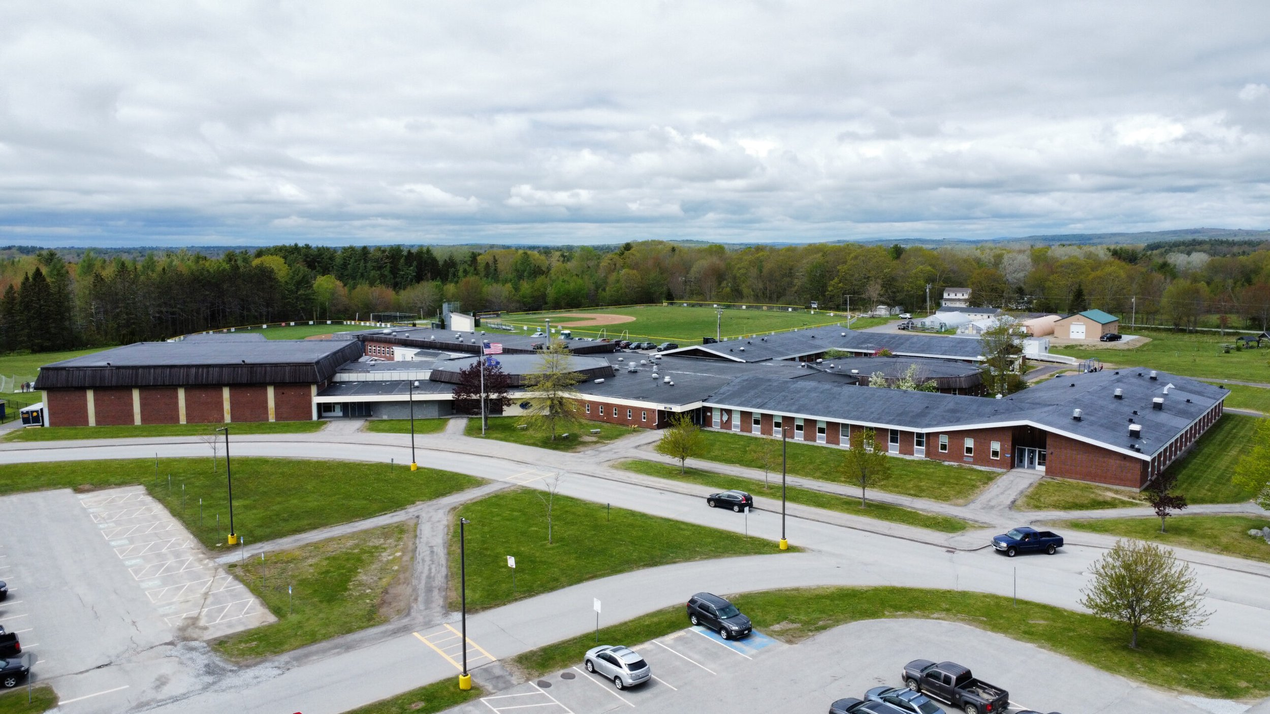


Medomak Valley High School
Renovation Project

Slide 6


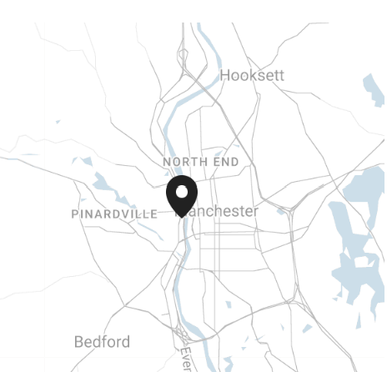
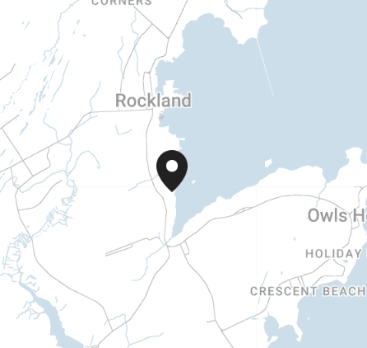

Novo Studio | Architects
Project Team
Our Locations
Anne Ketterer
Architect
K12 Design Expert
Steve Hebsch
Technical Leader
Building Code Expert
Manchester, NH
Owls Head, ME

Slide 7
Process
June 2026
July
August
September
October
November
December
January
February
Kick Off
Existing Conditions Analysis
Space Optimization
Design Options
Cost Estimating
Community Engagement

Slide 8
Timeline
Existing Conditions Analysis
Space Optimization
Design Options
Cost Estimating
Community Engagement
June 2026
July
August
September
October
November
December
January
February
Community Engagement
Weekly Meetings
Building Tour + Project Kick Off
Building Tour
Building Tour
Principal Interview
Teacher Interviews + Promotional Video
Facilities Committee Presentation
Submit Grant Application
Teacher Interviews
School Board Presentation
School Board Presentation
Project Review - Superintendent

Slide 9




Findings
Define Project Goals
Existing Conditions Analysis
Space Optimization
Cost Estimating
    Hazardous Materials
    Presence of asbestos flooring
    Water tank needs arsenic treatment system
    Safety & Security
    Missing Secure Entry Vestibule
    Missing sprinkler system
    ADA compliance issues (restrooms, science labs, administration, counseling suite)
    Seed program building in disrepair
    Inadequate / End of Useful Life
    plumbing
    ventilation system
    heating and cooling system upgrade
    electrical system
    Science labs
    Student restrooms
    Locker Rooms
    Auditorium seating
    Counseling Office is too small
    Art department is too large
    Special education department is scattered, spaces are inefficient
    Athletic program would benefit from additional gym space for team practices
    Athletic Team room is too small
    Existing locker rooms are too large
    Student resources are scattered and too small
    Special Education does not have a centralized department
    Focus on renovation of existing, no need for an addition
    Refine scope of work to meet project Needs vs project Wants
    Identify project goals
      Health and Safety
      Educational Delivery for 21st Century Learning

Slide 10
Project Goals
  1. Health and Safety
  Students and staff deserve a safe and healthy environment. The conceptual design focuses on addressing overdue issues of hazardous materials, code compliance and required systems upgrade.
  2. Space Optimization
  The conceptual design for the renovation of the Medomak Valley High School was carefully done through extensive teacher input, building assessment and viewed through the lens of strategic long-term planning to ensure the district can meet the demands for 21st century learning environments.
  3. Fiscally Responsible
  The conceptual design addresses the building needs, focusing solely on scope items that directly address the project goals of Health, Safety, Security and 21st Century Learning Environments.
    Remediate Hazardous Materials
    Address Code Compliance Issues
    Update Building Systems Function
    Address Accessibility
    Provide Secure Entry
Existing Conditions Building Needs
Space Optimization
Student Needs
    Student Resource Suite
    Centralized Special Education Department
    Renovate Science Labs
    Renovate Student Toilets
    Renovate Locker Rooms
Project
Budget
Community Needs
    The Cost Estimating team will provide multiple options for the school board to consider,
    The design will focus on the building and community NEEDS, not wants.

Slide 11
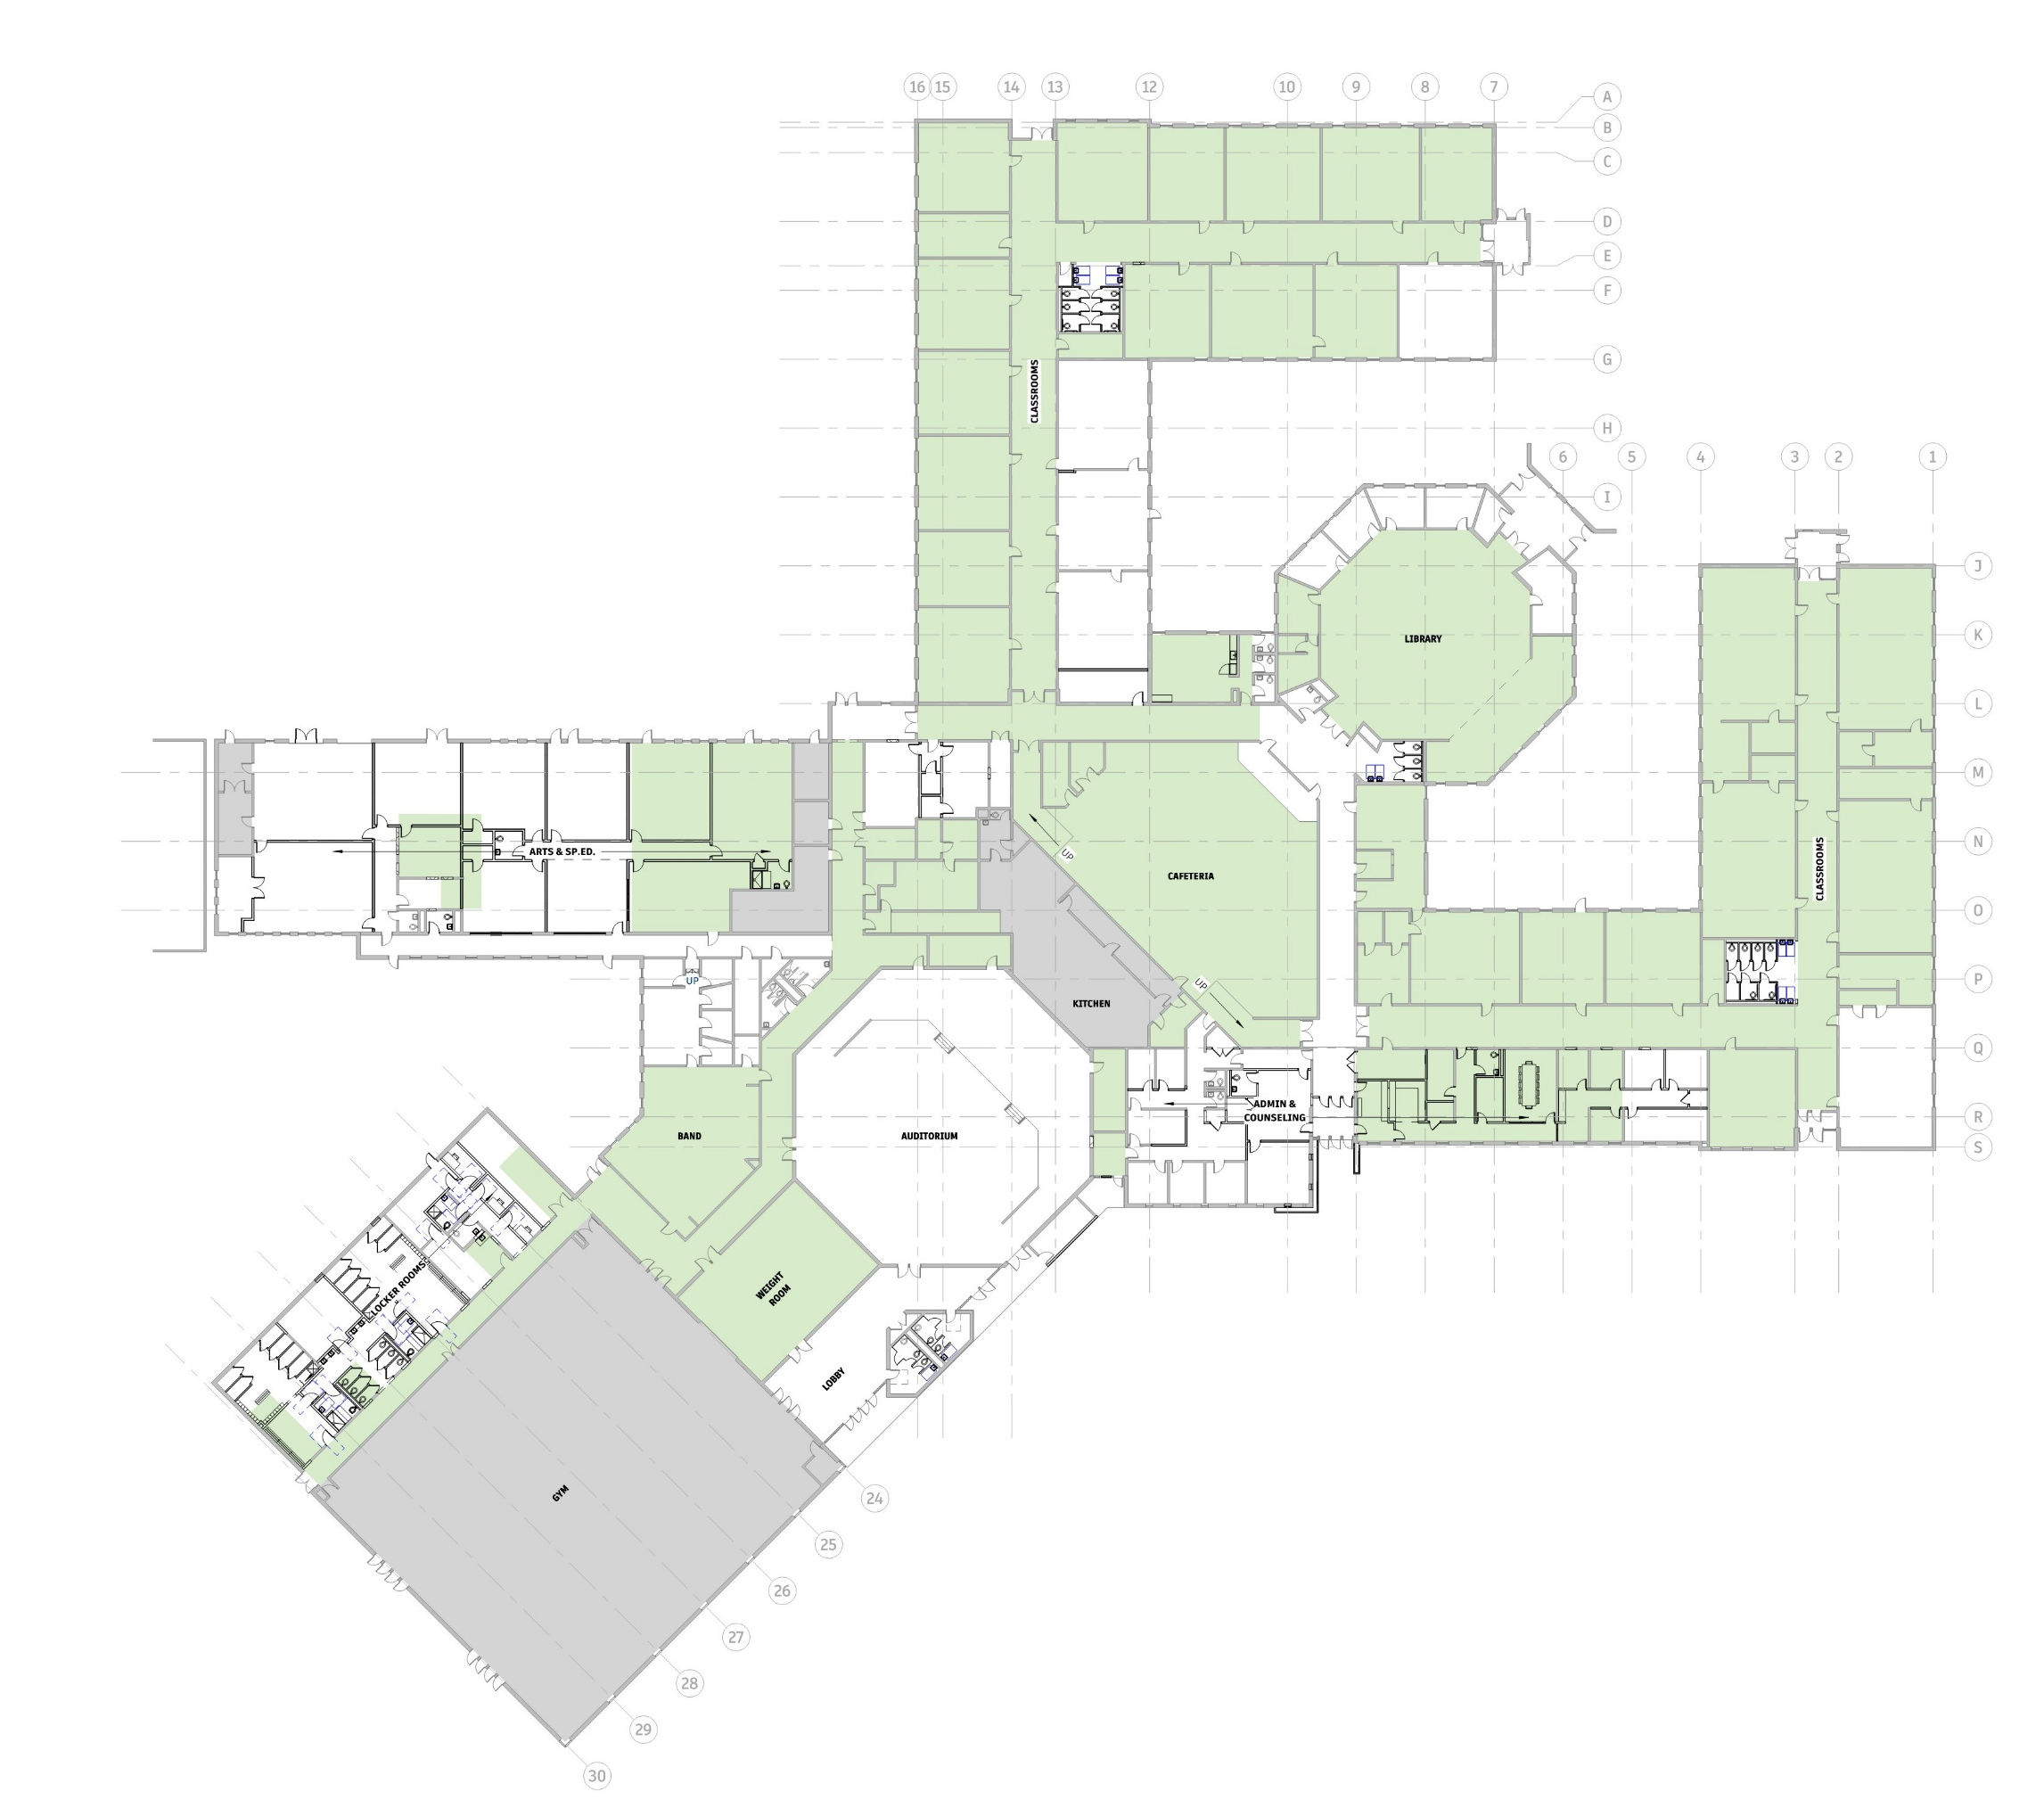
Designing to the Project Goals
Health & Safety
Existing Conditions Areas of Concern
1
2
    Flooring Remediation And Replacement
    Restrooms Renovation
    Locker Room Renovation
    Science Lab Renovation
    Secure Entry Vestibule
2
4
2
2
3
5
2

Slide 12
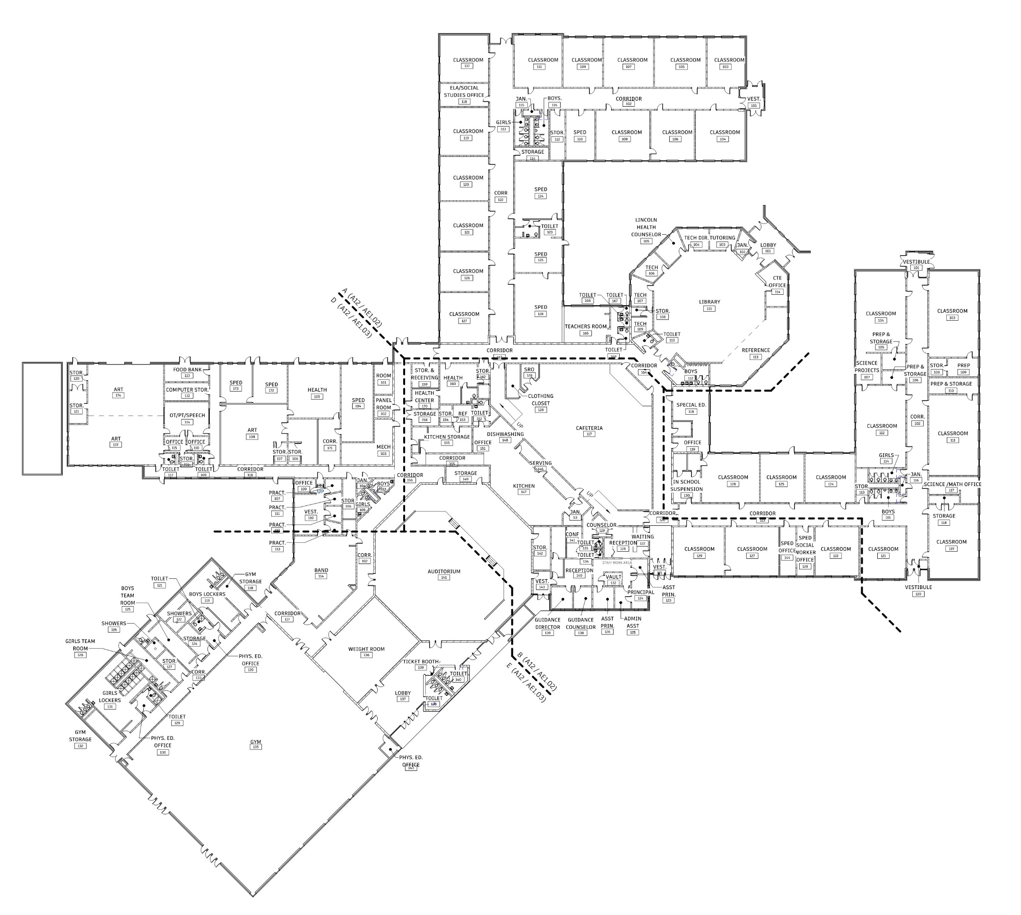
Designing to the Project Goals
Space Optimization Areas of Focus
    Student Resource Department
      Nurse + Maine Health
      Counseling Suite
      Donation Closet
    Special Education Department
    Art Department
3
2
2
1

Slide 13

Cost Estimating
Cost Control
Performance Contracting
Design Build Model

Slide 14
Q&A

Slide 15
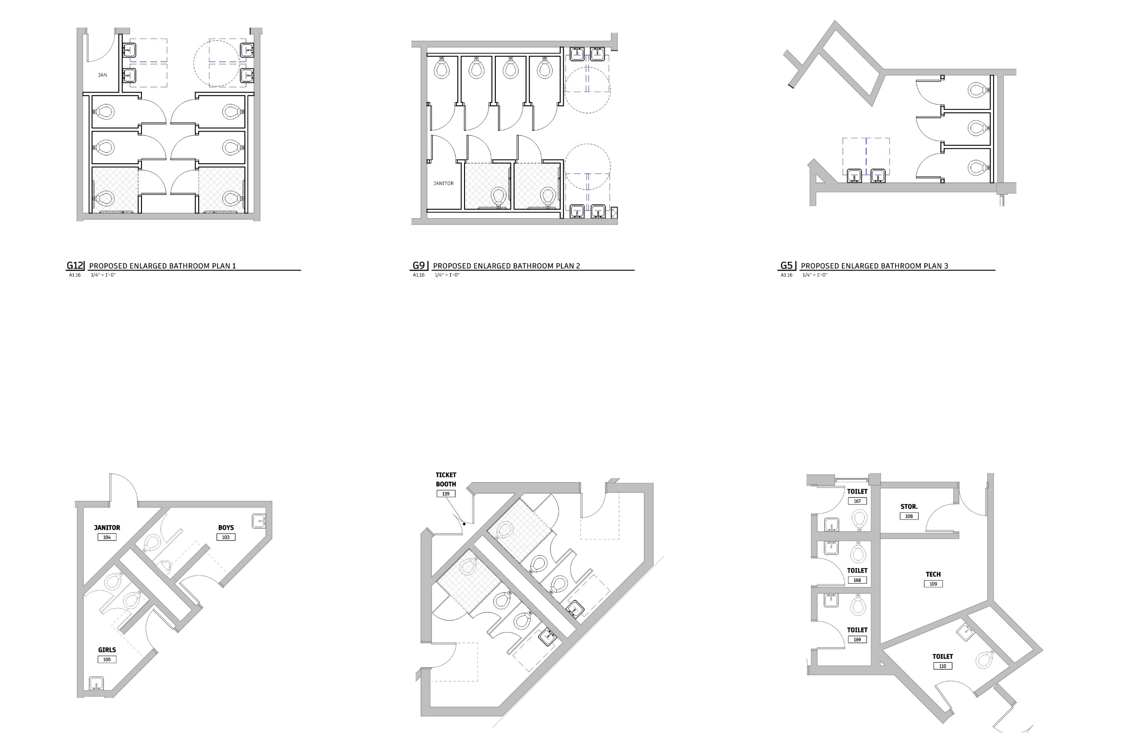
Floor Plans
Student Toilet Rooms

Slide 16
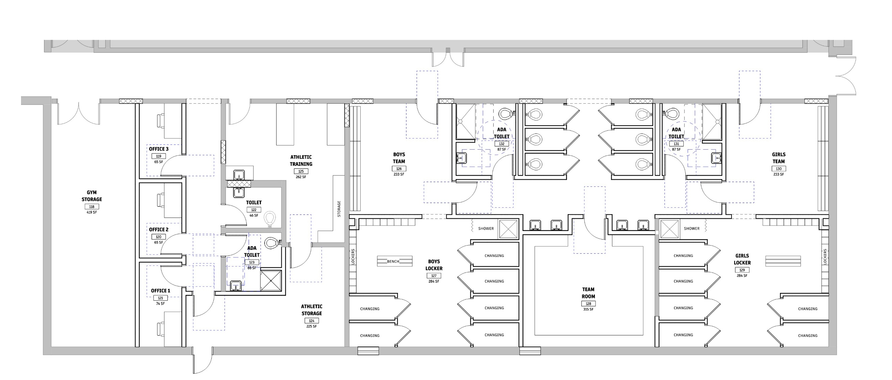
Floor Plans
Athletic Locker Rooms & Team Areas

Slide 17
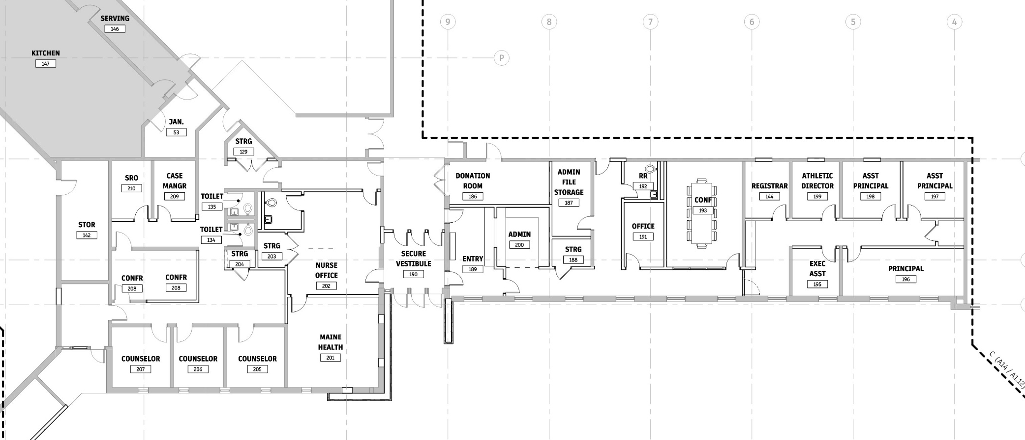
Floor Plans
Student Resource Department

Slide 18
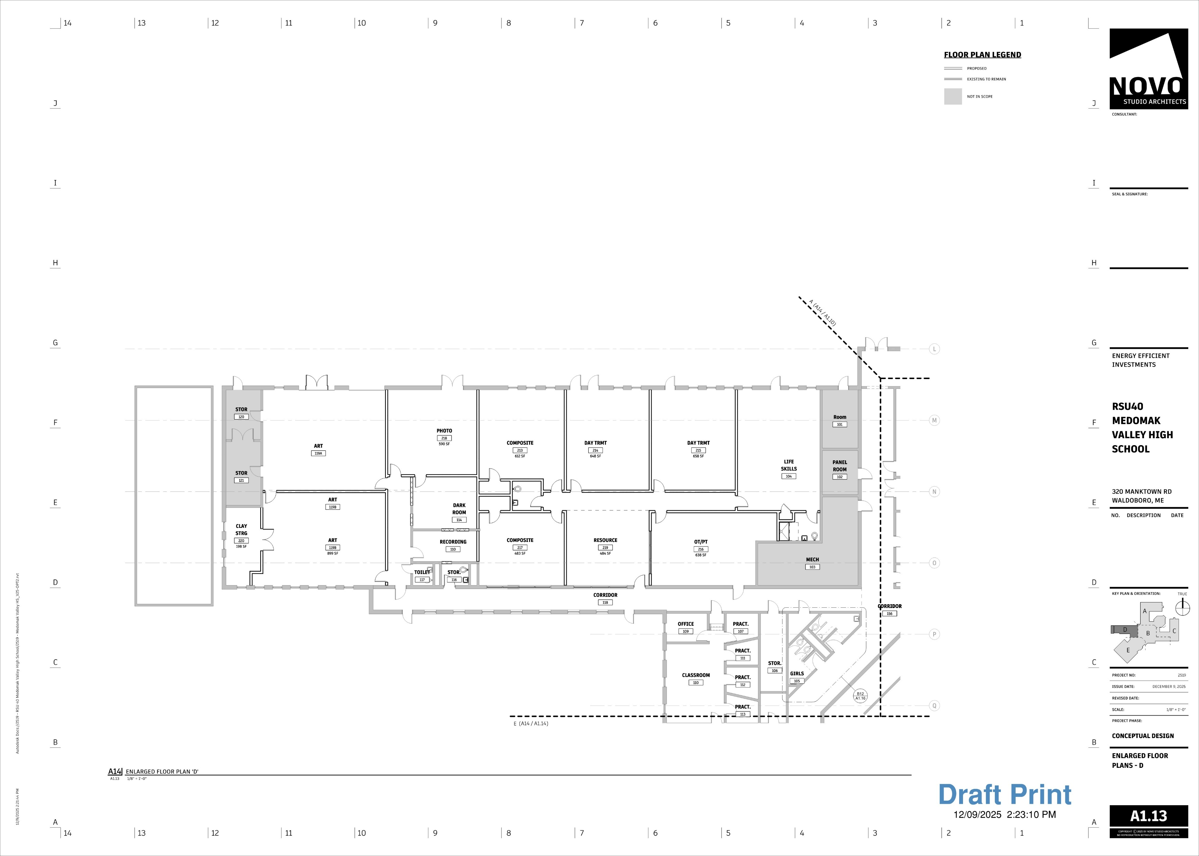
Floor Plans
Special Education Department

Slide 19
Floor Plans
Art Department

